Slide 1
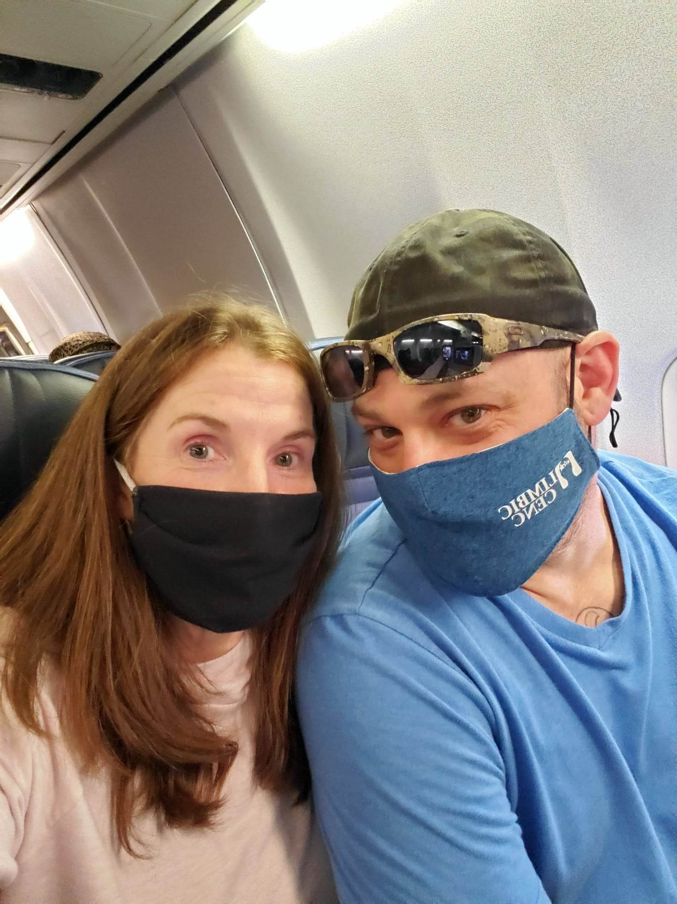
LIMBIC-CENC: Participant Travel
Joe Montanari

Slide 2
Objectives
Describe the travel process
Properly fill out the necessary documentation

Slide 3
Travel Process
Complete the LIMBIC-CENC Travel Form for the Participant
Securely email the from to the LIMBIC-CENC Retention Officer
Retention Officer will contact the participant and cover all the necessary information
During the visit, have the Participant complete the VCU Reimbursement Form

Slide 4
Reimbursements
Parking
Tolls
Taxi
Hotel (up to the site’s government rates)
Mileage
*In addition to these reimbursements, the participant will receive per diem for meals

Slide 5
LIMBIC-CENC Travel Form

Slide 6
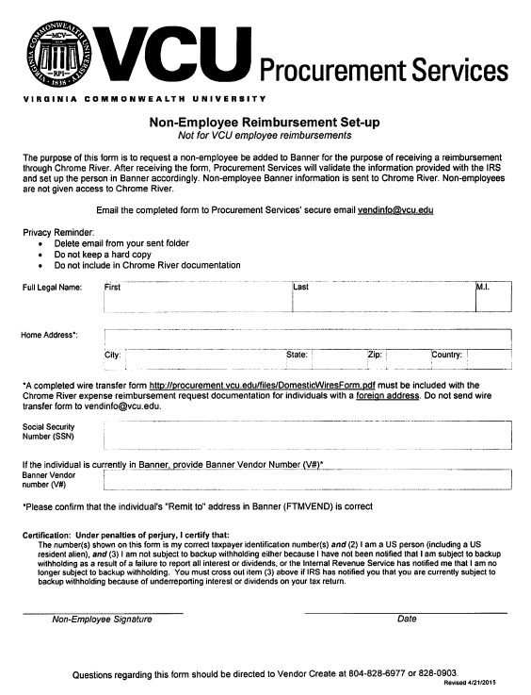
LIMBIC-CENC Travel Form

Slide 7
Key Notes
Forms
Emails
Confirmation of Dates/Times
Receipts
Make the most of the visit (blood draw and MRI)
Please Remember- Communication is Key!!!!!!!

Slide 8
Questions

