Slide 1
James A. Haley Veterans’ Hospital Tampa FL. LIMBIC CENC Team
“The Importance of Rapport”

Slide 2
Agenda
What is rapport?
How can rapport impact research?
HOW DOES THE JAHVH TAMPA TEAM PRACTICE RAPPORT?

Slide 3
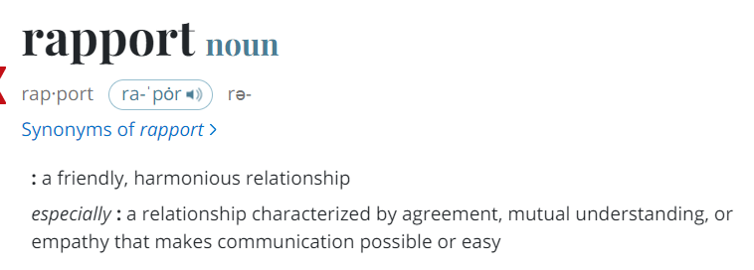
What is rapport?
Notes:
Merriam-Webster. (n.d.). Rapport definition &amp; meaning. Merriam-Webster. Retrieved May 1, 2023, from https://www.merriam-webster.com/dictionary/rapport

Slide 4
How does rapport impact research ?
How can IMPLIMENTING RAPPORT POSITIVLY IMPACT RESEARCH?
How can lack of rapport negatively impact research
- Helps study staff stay on the same page (relaying information, questions, comments, concerns)
- Creates positive environment for CENC research participants( questions, comments, concerns)
- Potential to positively impact CENC research participant view of healthcare providers; Could encourage CENC research participants to continue seeking healthcare services
- Confusion among study staff, miscommunication, frustration, potential to stall or halt the study itself
- Creates an uncomfortable environment for CENC research participants (do not feel comfortable asking questions, communicating with study staff)
- Potential to negatively impact CENC research participant view of healthcare providers; Could discourage CENC research participants from seeking healthcare services

Slide 5
Valerie Larson, MA, CCRC
If you have Veterans on staff, use the Military connection to open the lines of communication.
Humor!! Humor is a great way to break up the anxiety and tension of the testing. It can also make a very long testing day seem a bit shorter.
Mirror their language if possible. By using language the Veterans are familiar with, the Veterans are able to relax and open up to the staff easier.

Slide 6
Jennifer Boyce, LPN, CRC
By being the person responsible for scheduling follow-up visits, MRI appointments, making visit reminder calls and following those who are difficult to contact I interact with study participants over the telephone on a regular basis. They become familiar with me and are more likely to answer or return my calls.
Scheduling MRI appointments is a cumbersome task at our site. I work with participants to accommodate days and times that will meet their specific needs.
During the in-person visits being a nurse helps to make study participants more comfortable discussing their medical conditions and medications.

Slide 7
Deveney Ching, MA, CRC
As the first person who meets with a subject and starts the visit, using non-threatening and “safe topics” for initial small talk helps start conversations.
If you don’t understand an acronym, military jargon, or other statement a subject says, tell them you don’t know what that is. They’re usually happy to explain it to you. (I’ve even had a subject who asked for a blank piece of paper to draw me a diagram because he really wanted me to be able to visualize what he was describing to me.)
As the most heavily tattooed member of the Tampa CENC team, it helps to relate to our subjects about things in common. It’s the first thing that gets brought up and they talk about the ones they have or where they got them.

Slide 8
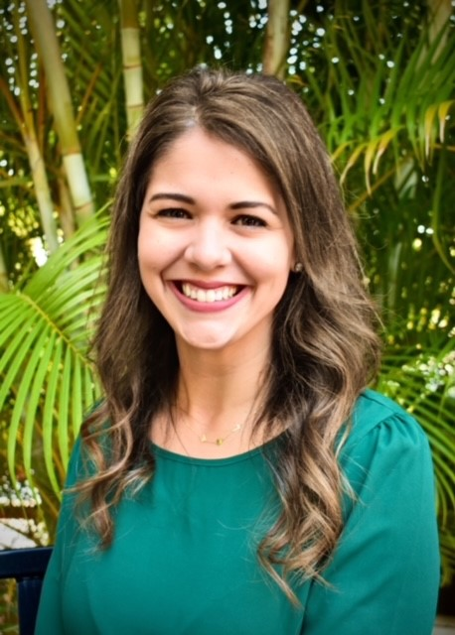
Michelle Gaudet, MS, CCC-SLP
A few tips for making Participants feel comfortable during Baseline or Follow-Up visits:
Manage expectations by being transparent about time commitment and outlining an agenda/schedule for the day.
Frequent check-ins to make sure Participant is comfortable. Pay attention to body language and offer breaks as needed.
Practice active listening, validate concerns, and encourage questions
- Try asking “What questions do you have?” instead of “Do you have any questions?”
- Show interest in what your Participant is saying

Slide 9
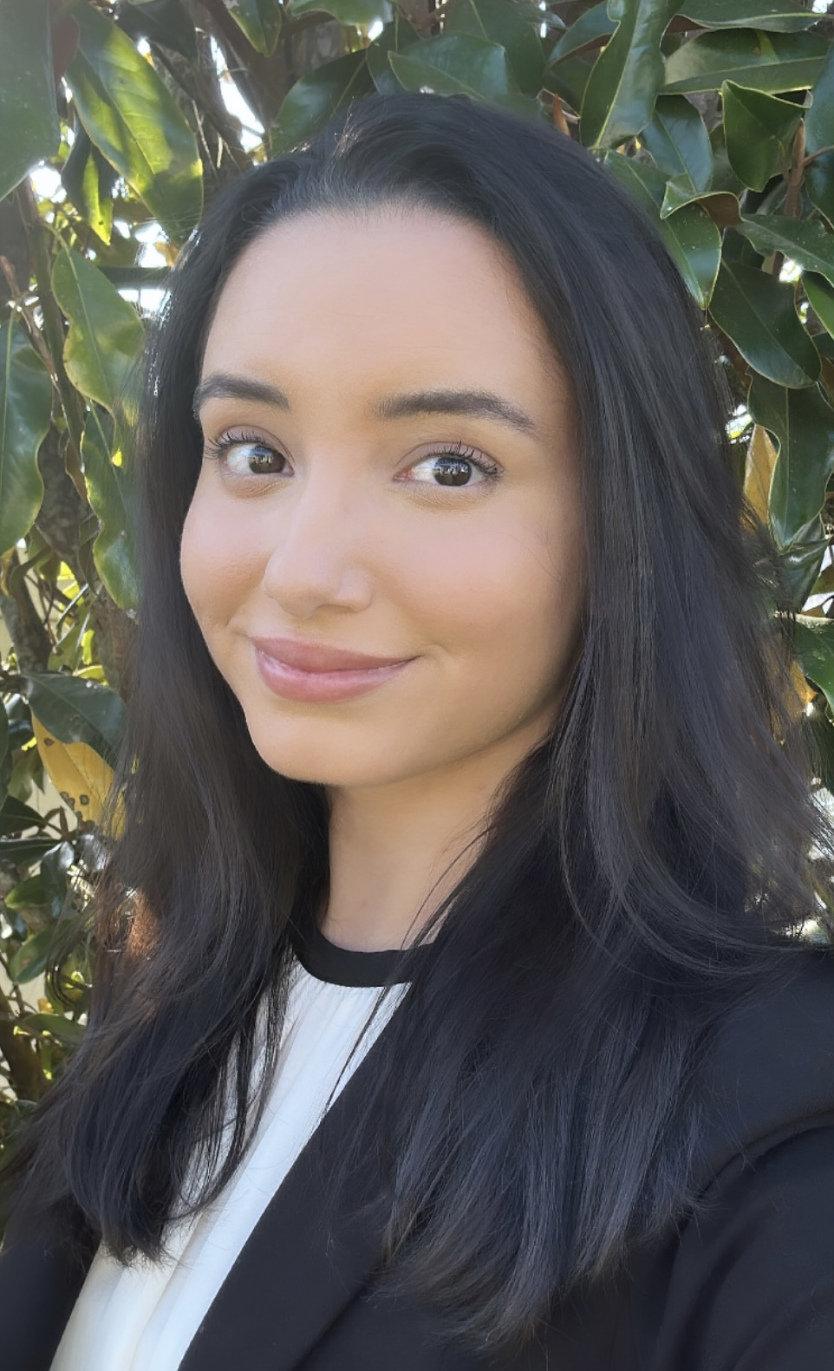
Illiana Suarez, BA
- It will always be important to Identify myself! I am a newer member of the study team and I will be administering the LCAM measures; I need to state who I am, what my role is, and give a brief overview of what the LCAM portion will consist of. Additionally, If I am asked a question about a portion of the study I do not oversee, I will connect them with a team member that can answer their questions or concerns appropriately.
- After introducing myself, I like to ask participants how they would like to be addressed. Asking “How would you like me to address you?” is my way of showing respect and making sure the research participant is comfortable.
- If a research participant asks me why I am interested in working with veterans, I disclose that I am a veteran dependent of a parent who sustained a TBI in combat. Although I am not a veteran myself, I am familiar with military culture and have tremendous respect and gratitude for the men and women who have served this country. This helps me relate to research participants.

Slide 10
Thank-you!

