Slide 1
Prognosis in traumatic Brain Injury
William C. Walker, MD
Ernst & Helga Prosser Professor
VCU Dept PM&R
10/25/23

Slide 2
Besides injury factors and patient characteristics, PROGNOSIS depends on:
Population considered
All cases
Hospitalized only
Acute rehab admissions only
Other
Time frame
Short term
Long term
Outcome being measured
Impairment (organ level)
Functional (person level)
Participation (person ↔ society)
Satisfaction
Global
Notes:
To determine prognosis, it is imperative to guide by literature from relevant population (i.e. how was sample selected) and clarify outcome(s) of interest and time-frame

Slide 3
Why Predict Short-Term Outcome?
Inpatient Rehabilitation is expensive ($500-1500/day); patients receiving it should have a realistic chance of returning home
Choosing the most appropriate setting for each patient requires a “best guess” of outcome
The patient, family, and rehabilitation team need an estimate of LOS and D/C goals as well as needs for aftercare planning

Slide 4
Why Predict Long-Term Outcome?
Financial planning
Disability planning
Long-term support system needs
Resource utilization planning

Slide 5
Outcomes of interest across care continuum
Acute Care Setting
Mortality
Disposition: Rehab vs SNF vs other
Consciousness
Complications: Sz, HC, herniation, elevated ICP, etc
Inpatient Rehab Setting (post-acute)
Impairment
Motor/balance or other focal neuro deficit
Cognitive/behavioral (TBI’s signature impairment; RLAS describes pattern of recovery for severe TBI)
Functional
Mobility/self-care
Functional cognition/communication
Disposition
Community vs Facility
ELOS and degree of assist
Long Term; additional outcomes
Employment
Other participation (eg. Driving)
IADLS/supervision needs
Satisfaction
Global

Slide 6
Rancho Los Amigos Scale (RLAS) stages of cognitive-behavioral impairment recovery after severe TBI
Coma
Vegetative
Minimally responsive (localizes, Not consistently FOC)
Agitated, Confused
Confused, Inappropriate
Confused, Appropriate
Automatic
Purposeful, Stand by Assist (SBA)
Purposeful, SBA on Request
Purposeful, Modified Independent

Slide 7
TBI; What Outcome Measures are common in literature?
Mortality
Glasgow outcome scale (GOS) (disability + handicap)
GOS extended (GOSE)
Disability rating scale (DRS) (disability + handicap + impairment)
Functional independence measure (FIM) (disability)
Return to work (handicap/participation)
Cognitive skills (impairment)
Measurement modes: Screening versus brief versus comprehensive (later typically done by neuropsychologists)

Slide 8
General Limitations of most Outcome Measures
Domain specific
Floor and ceiling effects
Social biases
Minority, age, and gender related differences
Modes of administration

Slide 9
Glasgow Outcome Scale (GOS)
GOS Level | Brief Description
Dead | N/A
Vegetative State | Condition of unawareness with only reflex responses but with periods of spontaneous eye opening.
Severe Disability | Dependent for daily support for mental and/or physical disability.
Moderate Disability | Some disability but able to look after themselves; Independent at home but dependent outside.
Good Recovery | Resumption of normal life with the capacity to work even if pre-injury status has not been achieved; May have minor neurological or psychological deficits.
Widely used in trauma and neurosurgical literature as global outcome measure
5 broad categories (limited sensitivity but easy to translate clinically)
Levels relevant for patients admitted to IRF with severe TBI
GOSE subdivides SD, MD and GR (added sensitivity for clinical trials research)

Slide 10
Disability Rating Scale (DRS)
Measures general global outcome
Developed in severe TBI patients
Aims to reflect functionally significant changes over entire spectrum of time (coma to community)
Contains measures of impairment (GCS items), disability (cognitive ability for ADLs) and handicap/participation (overall level of life function and employability)

Slide 11
Types of factors used for TBI outcome prediction
Demographics
Injury characteristics
Other clinical features (e.g. comorbidities)
Radiologic and electrophysiologic data
Influence of Interventions:
Rehabilitative
Surgical
Pharmacologic

Slide 12
Injury characteristics; TBI Severity Categories
 | Mild | Moderate | Severe
Initial GCS | 13-15 | 9-12 | <9
LOC duration | < 30 min | ½ - 24 hrs | >24hr
PTA duration | < 24 hr | 1-7 days | >7d
Imaging (CT) | Normal | + or - | + or -
Notes:
Head CT diagnosis utility:
Abnormal → r/out mild (r/in mod vs severe)
Normal → does NOT r/out severe TBI
If criteria have differing categories then use most severe unless clearly confounded by external factor

Slide 13
Injury Characteristics-Severity-Glasgow Coma Scale
Injury severity via GCS helps predicts mortality as well as 3, 6, & 12 month outcome (work, global, neurobehavioral)
Glasgow-Liege Scale (GCS + brainstem reflex) also predictive
Long-term predictive influence very weak compared to other severity measures
Main advantage is offers earlier prognostication
The best motor GCS and the best overall GCS within the first 24 hours is considered to be the best acute predictor of TBI outcome

Slide 14
What are specific limitations of early GCS?
Validity not well studied
Timing variability post-injury (e.g. a mild TBI can be comatose up to 30 min)
Predictability weakens progressively for longer horizons
Accuracy concerns; especially if intubated
Inappropriate for:
Young children
Severe facial injuries
Under heavy influence of ETOH or drugs

Slide 15
Far Better TBI Injury Severity Measures as predictors of long-term outcome
Length of coma
TBIMS surrogate measure is time to follow commands (TTFC)
Predictive of GOS, cognitive skills, RTW
proportionate relationship to outcome
Length of post-traumatic amnesia (PTA): Time to regain continuous memory of ongoing events
Prospective: PTA = < 75 on GOAT or >24 on O-Log; Other; Aphasia caveats
Retrospective: oriented x 3, recalled memory gap with anchors
Predictive of GOS, cognitive skills, RTW
Proportionate relationship
Single best predictor of outcome in TBI

Slide 16
TBI Length of Unresponsiveness; Caveats
Predictability stronger than GCS but weaker than PTA duration
☺ When emerge from coma < 3 weeks, > 50% regain independence in self-care
For emerging consciousness TBI group, when still in coma or vegetative at 4 weeks:
☺ > 50% regain consciousness
☺ Up to 44 % reach at least moderate disability on GOS
☺ 70% return to home by 2 years
☹ Chance of Good Recovery on GOS very low

Slide 17
PTA = Anterograde Amnesia after TBI
Term popularized by Russell & Smith 1961.
PTA is the period of time from the point of injury until the individual has a continuous memory for ongoing events (Whyte & Rosenthal, 1988).
The patient just emerged from PTA “remembers today what happened yesterday and does not begin each day with a blank mind” (Jennett & Teasdale 1981).
Also has been described as post-TBI confusional state, a form of delirium
Notes:
Generally equates to regaining full orientation (place, date, situation). In TBI-MS, PTA is measured prospectively with O-Log or GOAT (Galveston Orientation & Amnesia Test). Measured retrospectively if needed by daily documentation of orientation level.

Slide 18
DAI: Phase Time Relation
Cognitive Impairment c/w baseline
PTA duration

Slide 19
Walker WC, Ketchum JM, Marwitz JH, Chen T, Hammond F, Sherer M, Meythaler J. A multicentre study on the clinical utility of post-traumatic amnesia duration in predicting global outcome after moderate-severe traumatic brain injury. J Neurol Neurosurg Psychiatry 2010;81:87-89.

Slide 20
Overall Results: Improvement in GOS levels over outcome years
Walker WC, Stromberg KA, Marwitz JH, Sima AP, Agyemang AA, Graham KM, Harrison-Felix C, Hoffman JM, Brown AW, Kreutzer JS, Merchant R. Predicting long-term global outcome after traumatic brain injury: Development of a practical prognostic tool using the TBI Model Systems National Database. J Neurotrauma 2018;35(14):1587-1595. doi: 10.1089/neu.2017.5359.
Severe Disability
31.8% at 1-year post-injury
26.9% at 2-year
21.8% at 5-year
Good Recovery
35.9% at 1-year post-injury
39.5% at 2-year
42.0% at 5-year
Notes:
This finding corroborates prior studies of 5 year outcomes after severe TBI and highlights the enduring nature of the recovery process after severe TBI, unique among neurological disorders. It also hints at the difficulty of prognosis in that over time, more confounding factors are likely to impact outcomes (such as depression). A cross year analysis in the test and training sets comparing sample characteristics suggested the GOS change over time was from patients improving rather than biased drop-out.

Slide 21
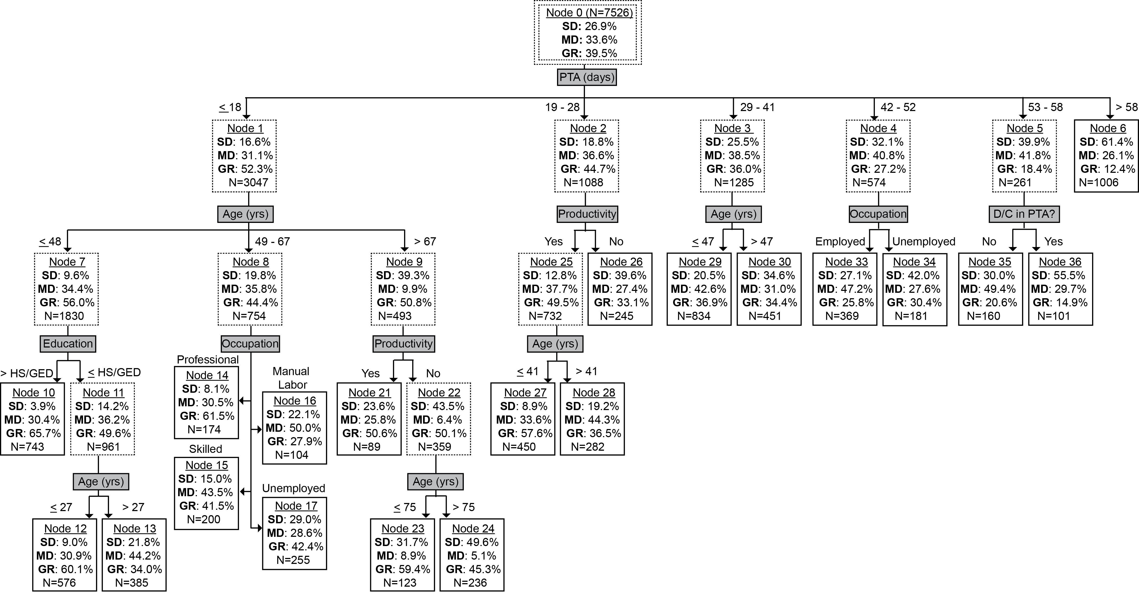
Year-2 GOS Prediction Tree
Notes:
Although details of days and rates differ, in 2-Yr GOS trees again see that PTA duration is at top of hierarchy and rate of SD climbs steadily across PTA duration groups while rate of GR drops steadily.
The longest PTA duration group again has no additional predictors; perhaps indicating a threshold.
In the next to longest PTA duration, those still in PTA are similar to the longest PTA group.
Age has predictive influence on the 3 shortest PTA duration groups.
Preinjury employment also adds predictive value to most branches.

Slide 22
Findings Pattern Summary
Injury Characteristics
PTA duration consistently dominated branching hierarchy
Not contributory: initial motor GCS, focal hemorrhagic mass lesion on head CT, elevated ICP, cranial surgery, and acute hospital LOS
Sociodemographic Characteristics
Age was generally the leading secondary predictor (after PTA)
Other contributors: premorbid education, productivity, & occupation
Not Contributory: sex, premorbid alcohol/drug misuse
Notes:
Sociodemographic variables seemed to have greater influence on later years.

Slide 23
PTA duration top predictor
Reinforces past TBI outcome prediction research
Groups with shortest PTA duration (best prognosis):
Upper cut-point increased from 16 days at year-1, to 18 days at year-2, to 20 days at year-5
GOS improved sequentially
Highest Good Recovery rate in any prognostic group is 65.7%
Groups with longest PTA (worse prognosis):
Lack of branching suggests a PTA duration threshold beyond which the TBI is so severe that it negates any secondary predictor influences; our data indicates this threshold is around 7 weeks.

Slide 24
PTA duration thresholds for Long Term GOS
☺ Very unlikely to have Severe Disability (SD)
PTA duration < 3 wks if not elderly
At 2yrs 5.8% SD for Age < 37; 31.8% SD for Age > 58
☹ Very unlikely to reach Good Recovery (GR)
PTA duration > 7-8 wks
At 2 yrs 1 in 8 reach GR
Data suggests the following meaningful Severe TBI subcategories:
1-3 wks PTA = Severe TBI
3-7 wks PTA = Very Severe TBI
> 7 wks PTA = Extremely Severe TBI

Slide 25
TBI Global Outcome Predictors: Other Injury Characteristics
Type: Penetrating vs Closed
Hemiparesis, other focal neuro deficit (PTA duration does not well capture focal injury)
Brainstem reflexes predict 3, 6, 12 month (work and function)
Intracranial Pressure (GOS, mortality; secondary injury marker)
> 20 mm Hg sustained worse outcome
> 40 mm Hg worse outcome
Medical Comorbidites (Acute care LOS often indicative) including concurrent traumatic stroke
Note: Etiology of TBI not shown as predictor except GSW as marker for penetrating TBI
Walker WC, Ketchum JS, Marwitz JH, et al. Global Outcome and Late Seizures after Penetrating versus Closed Traumatic Brain Injury (TBI): A NIDRR TBI Model Systems Study. J Head Trauma Rehabil 2015;30(4):231-240.
Jenkins RM, Manche NL, Sima AP, Marwitz JH, Walker WC. “Characterizing Comorbid Cerebrovascular Insults among Patients with TBI at a TBI Model Systems Rehabilitation Center”. J Head Trauma Rehabil 2020 Jan/Feb;35(1):E51-E59.

Slide 26
TBI outcome predictors: Patient background characteristics associated with poorer outcomes
Higher Age (adult population):
#2 most important predictor after PTA duration
Pediatric population note: Some studies show worse outcomes for < 4 yo. Also, cognitive or behavioral issues may not be evident post-acutely until that time, developmentally, that child would reach certain milestones; as the child grows and their brain develops, problems may emerge
Less Education
Unemployment and lower skilled occupations (especially for RTW prognosis)
Prior TBI
Prior psychiatric history
Female (mild TBI only)

Slide 27
TBI Predictors: Functional Measures
DRS at rehab admission and FIM at rehab admission correlates with discharge status and RTW at one year

Slide 28
Other Severe TBI Thresholds
Good long-term GOS unlikely for all severe TBI with any of these features:
Penetrating type
Also higher risk for posttraumatic epilepsy, persistent focal neurologic deficits (e.g. hemiparesis)
Age > 65
Bilateral brainstem abnl on imaging

Slide 29
TBI predictors: Radiologic Correlates
Intracranial masses
Cerebral contusions
Subdural worse than epidural hematoma
Midline shift > 10 mm
Brainstem lesions
Limited additional variance beyond PTA duration and age for long-term outcomes

Slide 30
Overall Results: Employed (
Stromberg KA, Graham KM, Agyemang AA, Walker WC, et al. Using Decision Tree Methodology to Predict Employment after Moderate to Severe Traumatic Brain Injury. J Head Trauma Rehabil 2019 May/Jun;34(3):E64-E74.
Year 1 = 33.6%
Year 2 = 37.5%
Year 5 = 40.6%

Slide 31
Summary from our employment study
PTA duration was primary predictor of employment
Nearly half of participants with less than 3 weeks of PTA duration employed at each follow up year
PTA duration of 3- to 4-weeks appears to be a critical demarcation between good employment prognoses and significant challenges
Group with longest PTA duration showed increasing rates of employment
Year 1: 17% → Year 2: 20.8% → Year 5: 29.4%
70% of individuals who spent more than 4 weeks in PTA remain unemployed at year 5
Similar to unemployment rates of individuals with disabilities in the US (65%)
Secondary Predictors:
Yr 1: Pre-injury Occupation
Yr 2: Pre-injury Employment, Education level
Yr 5: Education level

Slide 32
Other factors for guiding return to work (RTW) after TBI
Assessment of emotional and behavioral functioning is important
Assessment of cognitive functioning is important
Much depends on the demands of the individual’s specific job, employer attitude/accommodation, work history
Other factors include financial needs/incentives of work versus disability and retirement age factors

Slide 33
Return to Driving: determinates and predictors
Cognitive skills: Executive function, Attention, Memory
Visual-perceptual motor skills
Seizure history
Premorbid driving experience and skills (i.e. crash & moving violation history)
Resources (financial, other SDOH)

Slide 34
Prognosis in Mild TBI?
ER samples
Predictors of postconcussion symptoms (PCS): cognitive testing, female, MVA (vs athletic), LOC duration, event related stress, psych hx, severity of event pain, education
LOC +/- not predictive of neuropsych testing impairments
Athlete and Military samples
Predictors of early PCS: retrograde amnesia, PTA
NOT predictive: on field LOC
Predictors of Persistent PCS
Early symptom severity, Mental health history, prior mild TBIs, Female gender, comorbidities, litigation & work comp, emerging evidence on blast mechanism

Slide 35
Repetitive mild TBI may have unique poorer outcomes
Research findings are not conclusive, but
Linked to evidence for chronic traumatic encephalopathy (CTE), or dementia pugilistica and can result in extrapyramidal symptoms and pathology similar to Alzheimer's.
Anecdotal reports of repeat mild TBI before last mild TBI fully recovers (Second impact syndrome results from inability to autoregulate blood pressure after repeat concussion; this hypertensive emergency has resulted in death (in those younger than 18).

Slide 36
Definition of Mild TBI
A disruption of brain function resulting from a traumatic force to the head or brain
Indicated by new onset of at least one of the following:
Loss of consciousness (LOC) < 30 min
Post-traumatic amnesia (PTA) < 24 hr Loss of memory for events immediately after (+/- before) injury
Alteration of consciousness (AOC) Change in mental status at the time of injury such as confused, disoriented, or dazed
Neurological deficits that may or may not be temporary Seizure, weakness, loss of balance, paralysis etc

Slide 37
Mild TBI diagnosis Must Have: Evidence of immediate AOC
MSE during AOC window c/w AOC (or seizure)
Patient Interview after AOC window
Witness corroborated LOC (or seizure)
Memory gap pattern c/w TBI physiology
AOC symptoms c/w TBI physiology
Dazed
Confused
Saw Stars
Least specific
Walker WC, Cifu DX, Hudak A, Goldberg G, Kunz RD, Sima A. Structured interview for mild traumatic brain injury after military blast: inter-rater agreement and development of a diagnostic algorithm. J Neurotrauma 2015;32(7):464-73.
Most specific

Slide 38
Appendix
TBI prognosis versus other acquired Brain Injury conditions
GOS classification trees; Walker WC et al 2018

Slide 39
Prognosis in Acquired Brain Injury
Long Term; additional outcomes
Employment
Other participation (eg. Driving)
IADLS/supervision needs
Satisfaction
Global
Acute Care Setting
Mortality
Disposition: Rehab vs SNF vs other
Consciousness
Complications: Sz, HC, herniation, elevated ICP, etc
Inpatient Rehab Setting
Impairment
Motor
Cognitive/behavioral/communication
Functional
Motor
Cognitive
Disposition
Community vs Facility
ELOS
Remediation
Natural Recovery
Plasticity
Exercise
Other?
Effort
Compensatory
ADL-mobility training
Adaptation
External aids
Other?
Social Supports

Slide 40
Brain Injury Prognosis; Diffuse vs Focal injury
Diagnostic Category | Prevailing Impairment | Time until “Max”
Closed TBI (DAI esp) | Cognitive-Behavioral | Several Years
SAH | Cognitive-Behavioral | Several Months
Anoxic BI | Cognitive-Behavioral | Several Months
Stroke, Ischemic | Focal Neuro deficit | Several Months
Stroke, Hemorrhagic | Cognitive-Behavioral + Focal Neuro deficit | Several Months
Complex TBI (penetrating, DAI c/b traumatic stroke) | Cognitive-Behavioral + Focal Neuro deficit | Mixed

Slide 41
Other Diffuse Brain Injury conditions
Hypoxic
SAH
Similar to TBI, “good” physical outcomes can have residual cognitive, behavioral & social difficulties
Prognosis TBI > SAH > Hypoxic

Slide 42
Hypoxic/Ischemic BI
Often seen in conjunction with severe TBI
What brain regions are more susceptible to hypoxic injury?
Hippocampus
Basal Ganglia
Cerebellum
Outer Cortex Layer
Boundary zone injuries usually related to perfusion failure with injury confined to overlap territories of major cerebral

Slide 43
Subarachnoid Hemorrhage
Ruptured aneurysm cause in 70-90%
Aneurysms usually located at circle of Willis involving AntCommArt, MCA trifurcation, Carotid, & PostCommArt
40-45% die in first month
Many will have intracerebral component (infarct or hemorrhage)

Slide 44
Year-1 GOS Prediction Tree

Slide 45
Year-2 GOS Prediction Tree
Notes:
Although details of days and rates differ, in 2-Yr GOS trees again see that PTA duration is at top of hierarchy and rate of SD climbs steadily across PTA duration groups while rate of GR drops steadily.
The longest PTA duration group again has no additional predictors; perhaps indicating a threshold.
In the next to longest PTA duration, those still in PTA are similar to the longest PTA group.
Age has predictive influence on the 3 shortest PTA duration groups.
Preinjury employment also adds predictive value to most branches.

Slide 46
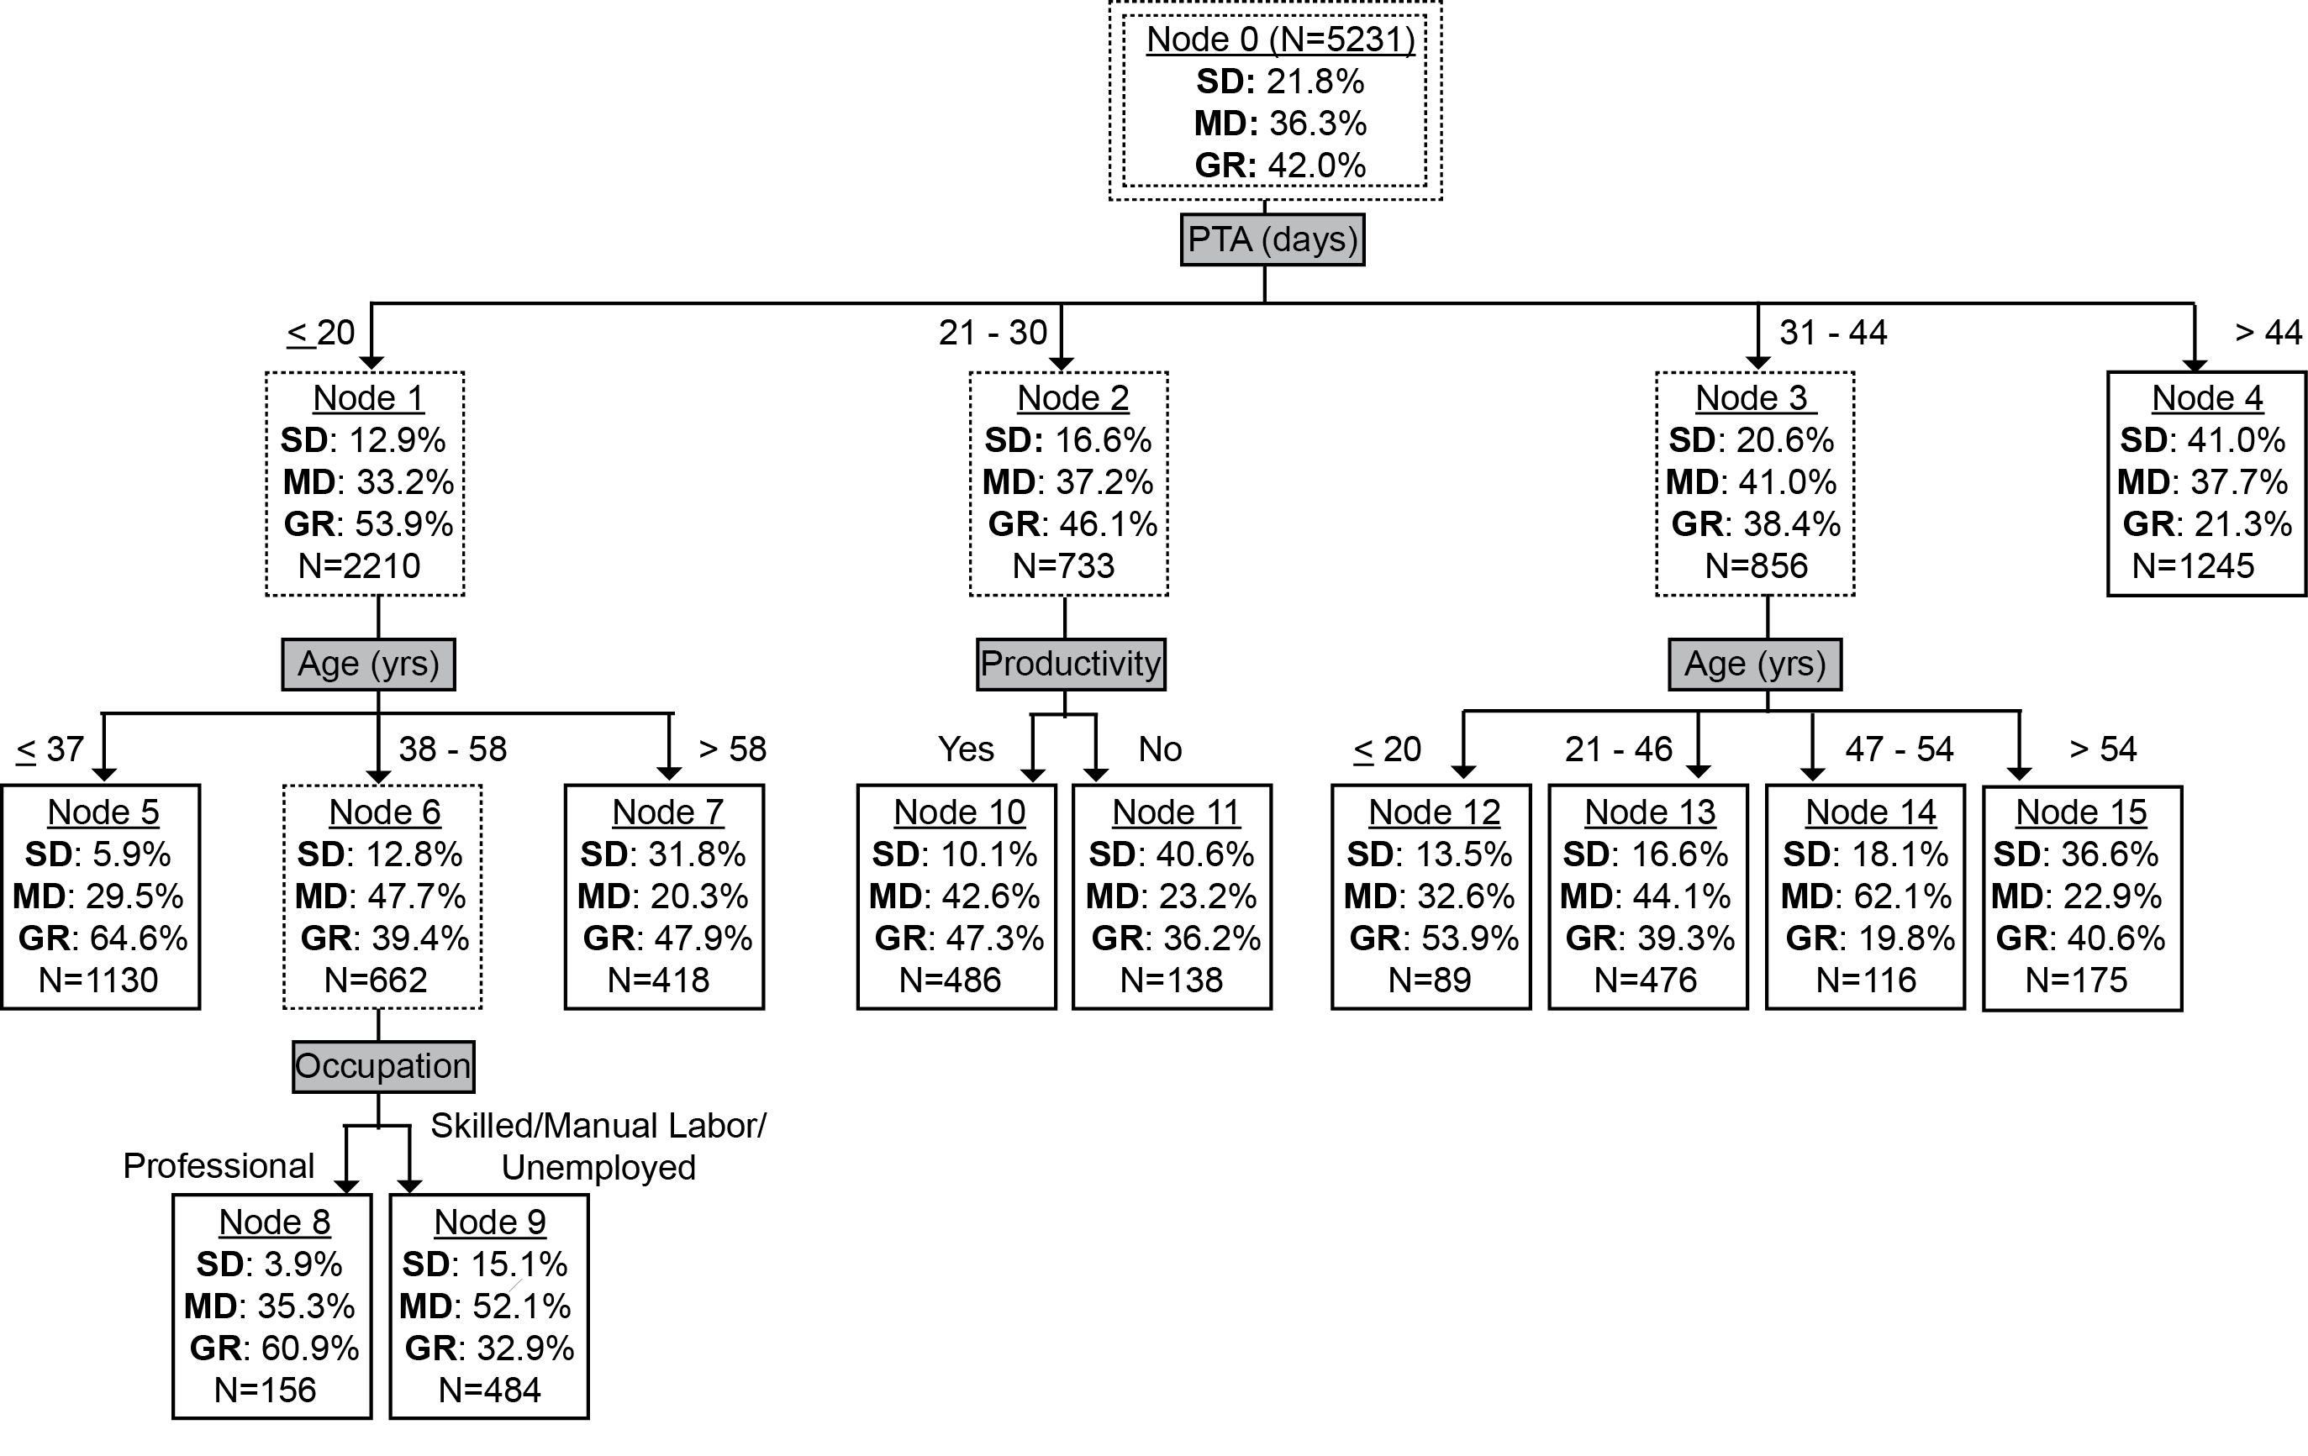
Year-5 GOS Prediction Tree
Notes:
PTA duration is at top of hierarchy.
Rate of SD climbs steadily across PTA duration groups while rate of GR drops steadily.
Over 6 weeks & 2 days is the worst prognostic group. Extended PTA duration seems to reach a threshold beyond which other variables don’t add meaningful predictability. The longest PTA duration in the one and two year trees also had a single node. In this group, the rate of SD was double the cohort average and the rate of GR was one half. Note that GR was still achievable by just over one fifth of the cohort.
Under 3 weeks is the best prognostic group. Higher age had a large effect on the chance of having SD despite favorable PTA duration. For those under 37 or middle aged (38-58) in professional occupations premorbidly, SD was very rare.
Predictions can be made with this variable alone. Under 3 wks PTA is best prognostic group.

