Slide 1
Relation of aerobic activity to cognition and well-being in chronic mild traumatic brain injury (TBI): A LIMBIC-CENC study
Walker WC, Wright B, Zhong C, Fisher R, Karmarkar A, Bjork JM, Pugh MJ, Hodges CB, Martindale SL, Wilde EA, Kenney K, McDonald SD, Scheibel RS, Newsome MR, Cook LJ
Background/Rationale:
Military persons commonly sustain mild TBI (mTBI) and often have chronic cognitive complaints
Regular aerobic exercise has been shown to improve cognition in other populations, however data is lacking for persons with chronic mTBI including Servicemembers (SMs) and Veterans (Vs)
The Long-Term Impact of Military-Relevant Brain Injury Consortium - Chronic Effects of Neurotrauma Consortium (LIMBIC-CENC) prospective longitudinal study (PLS) has a large cohort of combat-exposed SMs/Vs mostly with positive mTBI histories who have been comprehensively assessed neuro-cognitively
Objective: Determine if cognitive performance (primary aim), cognitive functioning and overall well-being (secondary aims) are related to aerobic physical activity levels among SMs/Vs with history of remote mTBI(s)
Notes:
Preregistered Hypotheses: objective cognitive performance and subjective well-being are better for those reporting higher levels of aerobic activity.

Slide 2
Methods:
Statistics: Multivariable regression
[n = 1,087 SMs/Vs]
Step 1: adjusting for fixed factors (e.g. age, estimated IQ, mTBI history (#, type (blast v. blunt, combat v. noncombat), years since)
Step 2: adjusting for state factors (e.g., sleep, PTSD, pain).
Inclusion: Positive mTBI history and valid cognitive test performance effort (MSVT) and symptom credibility (mBIAS)
IV: Physical activity data collected by the CDC Behavioral Risk Factor Surveillance System (BRFSS)
Aerobic Activity groups
Primary Outcome: Prespecified 7 memory, learning & executive function subtests:
California Verbal Learning Test-II
Long Delay Free Recall
Total Recall
Brief Visuospatial Memory Test-Revised
Total Recall
Trail-Making Test
Part B
NIH Toolbox Cognition Battery:
Picture Sequence Memory
Flanker
Dimensional Change Card Sort
Results for
Primary Outcomes:
Adjusted p-values > 0.05 for all group comparisons

Slide 3
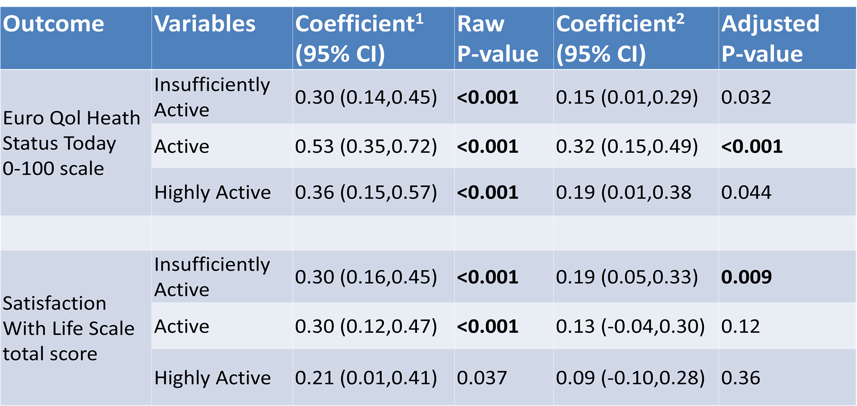
Abbreviated Results of Prespecified Secondary Outcomes
Exploratory analyses also showed a positive association with working memory and verbal fluency.
Reference Group: Inactive
¹First step regression ²Second step regression
Bolded p-values significant at Alpha = 0.05 with Bonferroni-Holmes correction factor (p<0.0125).

Slide 4
Relation of aerobic activity to cognition and well-being in chronic mild traumatic brain injury (TBI): A LIMBIC-CENC study
KEY POINTS
Question: Do Servicemembers and Veterans with remote mild TBI(s) who perform more aerobic physical activity have better cognition?
Findings Summary: Prespecified tests of executive function, learning and memory did not differ across aerobic level groups. However, regular aerobic activity was associated with better life satisfaction and perceived overall health status. Exploratory analyses also showed a positive association with working memory and verbal fluency.
Implications: Regular aerobic exercise is recommended for SMs and Veterans with chronic mild TBI. Future longitudinal analyses should seek evidence of objective cognitive enhancement or preservation not demonstrated with this cross-sectional analysis.

Slide 5
Credits and Acknowledgments
Department of PM&R, School of Medicine, Virginia Commonwealth University (VCU), Richmond, VA.
PM&R Service, Richmond Veterans Affairs Medical Center (VAMC)
Division of Epidemiology, Department of Internal Medicine, University of Utah, Salt Lake City, UT
Sheltering Arms Institute, Richmond, VA
Departments of Psychiatry, Pharmacology and Toxicology, PM&R, Institute for Drug and Alcohol Studies, VCU
VA Salt Lake City IDEAS Center for Innovation
Department of Internal Medicine, University of Utah School of Medicine, Salt Lake City, UT
Research Service Line, Washington, D.C. VA Medical Center, Washington, District of Columbia, USA
Research & Academic Affairs Service Line, W. G. (Bill) Hefner VA Healthcare System, Salisbury, NC, USA
Department of Physiology & Pharmacology, Wake Forest School of Medicine, Winston-Salem, NC, USA
George E. Wahlen VA Salt Lake City Healthcare System, Salt Lake City, UT, USA
Department of Neurology, University of Utah, Salt Lake City, UT USA
H. Ben Taub Department of Physical Medicine and Rehabilitation, Baylor College of Medicine, Houston, TX, USA
Uniformed Services University of the Health Sciences, Bethesda, MD, USA
Mental Health Service, Central Virginia VA Health Care System, Richmond, VA, USA
Department of Psychology, Virginia Commonwealth University, Richmond, VA, USA
Michael E. DeBakey Veterans Affairs Medical Center, Houston, TX, USA
Department of Pediatrics, University of Utah, Salt Lake City, UT USA
Presenter and Authors:
William C Walker, MD^{1,2}, Brennan Wright, MD¹, Chong Zhang³, Amol Karmarkar, PhD^{1,4}, James M Bjork, PhD⁵, Mary Jo Pugh, PhD^{6,7}, Cooper B Hodges, PhD^{1,8}, Sarah L Martindale, PhD^{9,10}, Elisabeth A Wilde, PhD^{11,12,13}, Kimbra Kenney, MD¹⁴, Scott D McDonald, PhD^{1,15,16}, Randall S. Scheibel, PhD^{13,17}, Mary R. Newsome, PhD^{13,17}, Lawrence J Cook, PhD,¹⁸.
COI, Funding Acknowledgements, & Disclaimers
There are no conflicts of interest for the authors to report in association with this project or presentation.
This work was supported by the Assistant Secretary of Defense for Health Affairs endorsed by the Department of Defense, through the Psychological Health/Traumatic Brain Injury Research Program Long-Term Impact of Military-Relevant Brain Injury Consortium (LIMBIC) Award/W81XWH-18-PH/TBIRP-LIMBIC under Awards No. W81XWH1920067 and W81XWH-13-2-0095, and by the U.S. Department of Veterans Affairs Awards No. I01 CX002097, I01 CX002096, I01 HX003155, I01 RX003444, I01 RX003443, I01 RX003442, I01 CX001135, I01 CX001246, I01 RX001774, I01 RX 001135, I01 RX 002076, I01 RX 001880, I01 RX 002172, I01 RX 002173, I01 RX 002171, I01 RX 002174, and I01 RX 002170. The U.S. Army Medical Research Acquisition Activity, 839 Chandler Street, Fort Detrick MD 21702-5014 is the awarding and administering acquisition office.
Opinions, interpretations, conclusions and recommendations are those of the author and are not necessarily endorsed by the Department of Defense or Veterans Affairs.

