Slide 1
Cognition and mild TBI history: Recent findings from the LIMBIC-CENC prospective study along with clinical translation
William C. Walker, MD
Objectives:
Understand the relationship between remote mTBIs and cognitive performance in the LIMBIC-CENC cohort
Understand the relationship that aerobic exercise/activities has with cognition and well-being in those with positive mTBI histories
Assimilate these recent findings into the research literature
Learn clinical strategies to address cognitive concerns among patients with prior mTBI

Slide 2
Branches of LIMBIC-CENC Research
Retrospective Database study (PI: Yaffe)
Phenotyping study (PI: Pugh)
Health Economics study (PI: Dismuke)
Prospective Longitudinal Study (PI: Walker)
PLS Biomarker study (PI: Kenney)
PLS Imaging Study (PI: Wilde)

Slide 3
Purpose of LIMBIC PLS
Background: The CENC PLS established a multicenter cohort of combat-exposed SM/Vs who underwent comprehensive 360⁰ evaluation of brain and neurologic health and function. The LIMBIC-CENC PLS continues to expand and serially assess the cohort.
Overall Goal: Answer critical questions about:
the long-term effects of mild traumatic brain injury (mTBI), including any evidence of neurodegeneration
the contribution of other factors on long-term post-deployment brain health
that will lead to improved patient care and life outcomes

Slide 4
Methods Synopsis
Comprehensive, holistic, 360 degree assessment of brain and neurologic health and functioning
Prospective follow-up (longitudinal) evaluations
Annual brief (< 1 hr) telephonic
Comprehensive full-day at least once every 5 years
Merging of retrospective (administrative) data
Scientific analyses
LIMBIC internal analyses of prospective data, longitudinal and cross-sectional
Collaborations with other scientific stakeholders
Sharing of datasets directly from external requests and through the FITBIR
Leveraging cohort for
Dual study enrollment
Additional funding opportunities with added research aims
Notes:
Refer to appendix for study assessment synopsis and serial time-line

Slide 5
Protocol Content Highlights
Establishing lifetime mild TBI history
Highly standardized and quality-controlled process
Mapping of all potential concussive events (PCEs) during lifetime
Modification of OSU TBI-ID Interview
Determining mTBI diagnosis for each PCE
VCU retrospective Concussion Diagnostic Interview (VCU rCDI)
Full assessment battery summary
Neurocognition emphasis (primary outcome)
Advance neuroimaging and biomarkers
Co-factors and confounders
Sensory impairments
Converging symptom, structural, physiologic, and functional outcomes
Notes:
Mapping of all potential concussive events (PCEs) during lifetime
Modification of OSU TBI-ID Interview
Entire lifetime divided into deployment and non-deployment times of life
Determining mTBI diagnosis for each PCE
VCU retrospective Concussion Diagnostic Interview (VCU rCDI)
Site PI vets structured algorithm diagnosis against open ended interview and medical record findings
Central TBI diagnosis committee for questionable events
Ongoing mass audits

Slide 6
PLS Eligibility Criteria
Prior Military Combat Deployment
Under CENC Post-911 deployment was required; Under LIMBIC: any era permitted
Combat Exposure (CE)
Deployment Related Risk Inventory (DRRI-2) combat CE module of at least 1 point
Absence of TBI severity > mild (e.g. moderate or severe TBI)
Both mild TBI and TBI negative (controls) are permitted
Absence of Major Neurologic d/o (e.g. SCI) or Psychiatric d/o (e.g. schizophrenia)
Most neuro or psych disorders are permitted (e.g. PTSD, mini-stroke)
Notes:
DRRI = Deployment Risk and Resilience Inventory

Slide 7
LIMBIC-CENC Prospective Longitudinal Study Enrollment & Testing Sites
# | Location | Name | PI
01 | Richmond, VA | Hunter Holmes McGuire VA Medical Center | William Walker, MD David Glazier, MD
02 | Houston, TX | Michael E. DeBakey VA Medical Center Baylor College of Medicine | Randall Scheibel, PhD Maya Troyanskaya, MD
03 | Tampa, FL | James A. Haley Veterans’ Hospital | Risa Richardson, PhD Shannon Miles, PhD
04 | San Antonio, TX | South Texas Veterans’ Health Care System | Carlos A. Jaramillo, MD, PhD
05 | Ft. Belvoir, VA | Fort Belvoir Community Hospital Henry M. Jackson Foundation for the Advancement of Military Medicine, Inc. | Melissa Guerra, MD
06 | Portland, OR | VA Portland Health Care System | Kathleen Carlson, PhD
07 | Minneapolis, MN | University of Minnesota | Scott Sponheim, PhD Nicholas Davenport, PhD
08 | Boston, MA | VA Boston Healthcare System | Terri Pagoda, PhD
09 | Salisbury, NC | W.G. (Bill) Hefner VA Medical Center | Sarah Martindale, PhD Jared Rowland, PhD
10 | San Diego, CA | VA San Diego Healthcare System/Camp Pendleton | Amy Jak, PhD Jason Bailie, PhD
11 | Fort Gordon, GA | Dwight D. Eisenhower Army Medical Center | John Rigg, MD Scott Mooney, PhD
Sites added under LIMBIC in red font

Slide 8
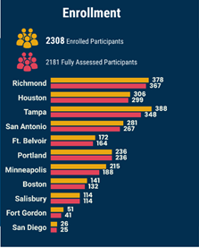
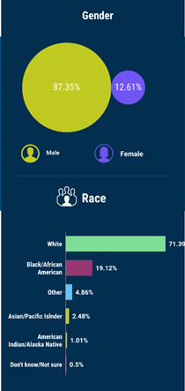
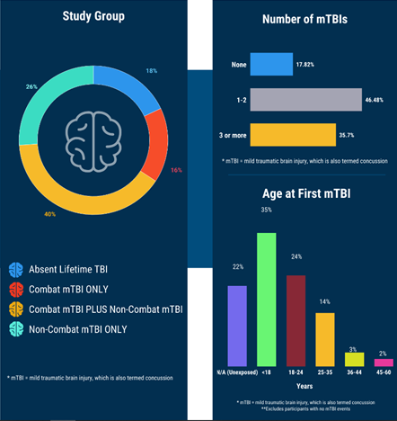
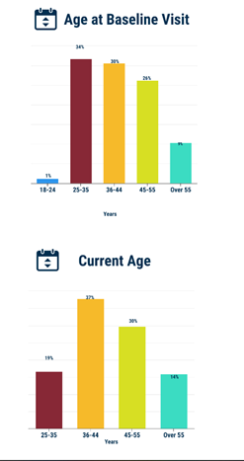
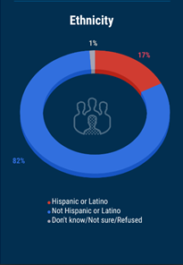
Notes:
Characteristics of LIMBIC-CENC PLS cohort almost identical to broader OEF/OIF deployed population:
Not White 29% (White 71%); Hispanic 17%; Female 13%
Major Depression (PHQ9 > 10): 38%
PTSD (PCL5 >= 33): 37%
TBI data:
TBI negative (controls) 18%.
Median # lifetime mTBIs = 2.

Slide 9
Can mild tBI alter cognition chronically? A LIMBIC-CENC multicenter study
Walker WC, O’Neil ME, Ou Z, Pogoda TK, Belanger HG, Scheibel RS, Presson AP, Miles SR, Wilde EA, Tate DF, Troyanskaya M, Pugh MJ, Jak A, Cifu DX.
Neuropsychology. 2022 Sep 29. doi: 10.1037/neu0000855. Online ahead of print. PMID: 36174184.

Slide 10
Background
Severe TBI: well-demonstrated long-term effects and considered a chronic disease
The signature long-term impairments are neurocognitive and neurobehavioral
Outcome from mild traumatic brain injury (mTBI) is generally favorable
HOWEVER:
Poor subjective outcomes after mTBI are common (i.e., PPCS)
Concern remains over other potential negative long-term effects of mTBI
A leading candidate, and arguably most critical, is altered cognition.
Demonstrating objective deficits has been elusive with inconsistencies in literature

Slide 11
Study Objective
Objective: Examine the link between cognitive performance and remote mTBI history within the LIMBIC-CENC PLS cohort of U.S. Veterans and SMs with combat exposure.
Aim: Determine the amount of unique versus shared variance for mTBI history, comorbidities, and other potential contributing factors on current, objective, cognitive performance.

Slide 12
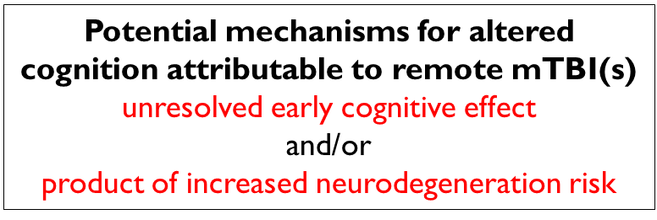
Study Hypothesis
Main Hypothesis: >= 3 lifetime mTBIs (repetitive mTBI) is associated with lower cognition as compared to those with no mTBIs (TBI negative controls).
Associated hypothesis: 1-2 mTBIs will also have lower cognition vs controls
Other aspects of mTBI history examined:
total number of mTBIs,
mechanism (blast versus blunt), and
elapsed time between mTBI event(s) and time of testing

Slide 13
Study Methods
Design: Cross Sectional using baseline (enrollment) assessments only (n = 1,551)
Primary outcomes: preselected multi-dimensional set of cognitive tests
Exclusions: performance validity failure (MSVT, CVLT or WAIS-IV; n = 241))
TBI positive groups, non-repetitive (1-2) and repetitive (3+), were compared to TBI negative controls on each of the seven cognitive domains (n = 1,310).
Multivariable regression models (n = 1,129) that adjusted for covariates
P-values were adjusted for multiple comparisons.
Notes:
LIMBIC-CENC PLS cognitive test battery
Spectrum of traditional neuropsychological tests
Recently developed computerized NIH Toolbox Cognition Battery.
All instruments recommended NIH Common Data Elements for mTBI.

Slide 14
Domains | Component Test Scores
Episodic memory | CVLT-II: Trials 1-5 total; Long Delay Free Recall BVMT-R: Total Recall NIH-TB-CB Picture Sequence
Attention | TMT Part A
Processing speed | WAIS-IV Processing Speed Index NIH-TB-CB Pattern Comparison
Working Memory | WAIS-IV Working Memory Index NIH-TB-CB List Sorting
Executive functioning | TMT Part B WAIS-IV Visual Puzzles NIH-TB-CB Dimensional change card sort test NIH-TB-CB Flanker Inhibitory control
Verbal Fluency | D-KEFS VFT: Letter fluency; Category fluency
Fine Motor & Dexterity | Grooved Pegboard: Dominant; Non-dominant
Domain scores were computed by averaging Z-scores of component tests.
Abbreviations: CVLT-II = California Verbal Learning Test-II; BVMT-R = Brief Visuospatial Memory Test-Revised; NIH TB-CB = NIH Toolbox Cognition Battery; TMT = Trail Making Test; WAIS-IV = Wechsler Adult Intelligence Scale 4th Edition; DKEFS = the Delis–Kaplan Executive Function System

Slide 15
Multivariable (adjusted) linear regression models; 3+ and 1-2 mTBIs vs TBI negative controls
 | Episodic Memory |  |  | Attention |  |  | Processing Speed |  |  | Working Memory
Variable | Coefficient (95% CI) | p-value |  | Coefficient (95% CI) | p-value |  | Coefficient (95% CI) | p-value |  | Coefficient (95% CI) | p-value
 |  | Raw | Adjust |  | Raw | Adjust |  | Raw | Adjust |  | Raw | Adjust
mTBI Positive Groups versus TBI Negative Controls
1-2 mTBIs | -0.06 (-0.17, 0.05) | 0.26 | 1 | -0.09 (-0.24, 0.07) | 0.26 | 1 | -0.01 (-0.12, 0.10) | 0.90 | 1 | 0.02 (-0.08, 0.13) | 0.70 | 1
3+ mTBIs | -0.03 (-0.16, 0.09) | 0.60 | 1 | 0.04 (-0.14, 0.22) | 0.65 | 1 | -0.04 (-0.17, 0.09) | 0.54 | 1 | 0.02 (-0.10, 0.14) | 0.76 | 1
 | Executive Function |  |  | Verbal Fluency |  |  | Fine Motor & Dexterity
variable | Coefficient (95% CI) | p-value |  | Coefficient (95% CI) | p-value |  | Coefficient (95% CI) | p-value
 |  | Raw | Adjust |  | Raw | Adjust |  | Raw | Adjust
mTBI Positive Groups versus TBI Negative Controls
1-2 mTBIs | -0.08 (-0.16, 0.00) | 0.06 | 0.42 | 0.05 (-0.08, 0.18) | 0.42 | 1 | -0.02 (-0.16, 0.12) | 0.77 | 1
3+ mTBIs | -0.04 (-0.14, 0.05) | 0.39 | 1 | 0.17 ( 0.03, 0.32) | 0.022 | 0.15 | 0.01 (-0.15, 0.16) | 0.95 | 1
Summary of Findings: adjusted p values were > 0.05 on all seven prespecified cognitive domain scores

Slide 16
Covariate findings & Sensitivity analyses
Covariates with effects:
largest and most consistent: Age, Education, Estimated Pre-morbid intelligence
Others: Gender, Race, Vestibular symptoms (Grooved Pegboard)
Sensitivity Analyses (separate multivariable models with other TBI history variables)
Continuous number of mTBIs
Number of blast-related mTBIs
Time since first and last mTBI (excluded mTBI positive only)
For every TBI history variable, adjusted p values were also > 0.05 on all seven prespecified cognitive domain scores

Slide 17
Conclusions
Among combat-exposed Veterans and SMs, mTBI history was not associated with performance on any cognitive testing domain when adjusting for other factors.
More evidence that in unselected samples, lower cognitive performance from mTBI(s) alone does not chronically persist relative to controls
Also no evidence that Blast-related mTBI has a unique deleterious chronic effect on cognition.

Slide 18
Take-home for research and clinical care
Key Evidence: Remote mTBI(s) alone, even if repetitive, is not associated with objective cognitive problems in the average combat-exposed Veteran or SM
Assimilation: This is consistent with the weight of the pre-existing research literature
Clinical Translation: A holistic healthcare approach including comorbidity assessment is indicated for patients reporting chronic cognitive difficulties after mTBI(s), and strategies for addressing misattribution may be beneficial.
Research Translation: Future study is recommended to assess phenotypes (e.g. cognitive impaired) and longitudinal decline from potential neurodegeneration.
Notes:
Question: Is cognitive performance altered long-term after mTBI?
Findings: Among combat-exposed SMs and Veterans, neither of the mTBI positive groups, non-repetitive or the repetitive (>3), differed from the TBI negative controls on any cognitive testing domain when adjusting for other factors.
Meaning: Cross-sectional analysis does not support an association between remote mTBI(s) alone and objective cognitive problems in the average Veteran or SM.
Clinical Translation: A holistic healthcare approach including comorbidity assessment is indicated for patients reporting chronic cognitive difficulties after mTBI(s), and strategies for addressing misattribution may be beneficial.
Research Translation: Future study is recommended to assess phenotypes (e.g. cognitive impaired) and longitudinal decline from potential neurodegeneration.

Slide 19
Relation of aerobic activity to cognition and well-being in chronic mild traumatic brain injury; A LIMBIC-CENC study
Wright B, Zhong C, Fisher R, Karmarkar A, Bjork JM, Pugh MJ, Hodges CB, Martindale SL, Wilde EA, Kenney K, McDonald SD, Scheibel RS, Newsome MR, Cook LJ, Walker WC.
Question: Do SMs & Vs with remote mild TBI(s) who perform more aerobic physical activity have better cognition?

Slide 20
Background/Objectives/Methods
Background:
Cognitive complaints are common in chronic stage of mild TBI
Regular aerobic exercise shown to improve cognition in healthy persons and neurologic conditions, but data is lacking on benefit for persons with chronic mTBI including SMs and Vs
Objective:
Determine the relationship between self-reported aerobic physical activity and objective cognitive test performance in SMs/Vs with remote history of mTBI.
Methods
Participants: Positive mTBI histories and passed performance and symptom validity tests
physical activity data from CDC BRFSS; categorized into 4 aerobic activity level groups
2-step multivariable regression adjusting first for fixed factors (e.g. age) and then adding state factors (e.g., pain).
Notes:
Preregistered Hypotheses: psychosocial and cognitive performance outcomes are better among participants with mTBI who self-reported higher levels of aerobic activity.
performance validity (MSVT) and symptom validity (mBIAS)
BRFSS = Behavioral Risk Factor Surveillance System
Relation between aerobic activity level and outcomes assessed with 2-step multivariable regression adjusting first for fixed factors (e.g., age, estimated IQ, combat history) and then adding state factors (e.g., sleep, PTSD, pain).

Slide 21
Results Summary
Final analytic sample (n=1087)
classified as ‘inactive’ (23%), ‘insufficiently active’ (46%), ‘active’ (19%), or ‘highly active’ (13%) based on level of reported aerobic activity.
Primary Outcome Analysis
Prespecified/preregistered: 7 tests of memory, learning and executive function (CVLT LDFR and Total Recall, BVMT-R Total Recall, TMT-B, and NIHTB-CB Picture Sequence Memory, Flanker, and DCCS).
Adjusted p-values were > 0.05 for all group comparisons on all seven primary outcome measures
Secondary Outcomes
Better Life Satisfaction and Perceived Health Status with higher Aerobic Exercise levels
Exploratory Outcomes
Better working memory (WAIS-IV) and verbal fluency (DKEF) with higher Aerobic Exercise levels
Notes:
Primary Outcomes spelled out: California Verbal Learning Test-II Long Delay Free Recall and Total Recall, Brief Visuospatial Memory Test-Revised Total Recall, Trail-Making Test Part B, and NIH Toolbox Cognition Battery Picture Sequence Memory, Flanker, and Dimensional Change Card Sort tests

Slide 22
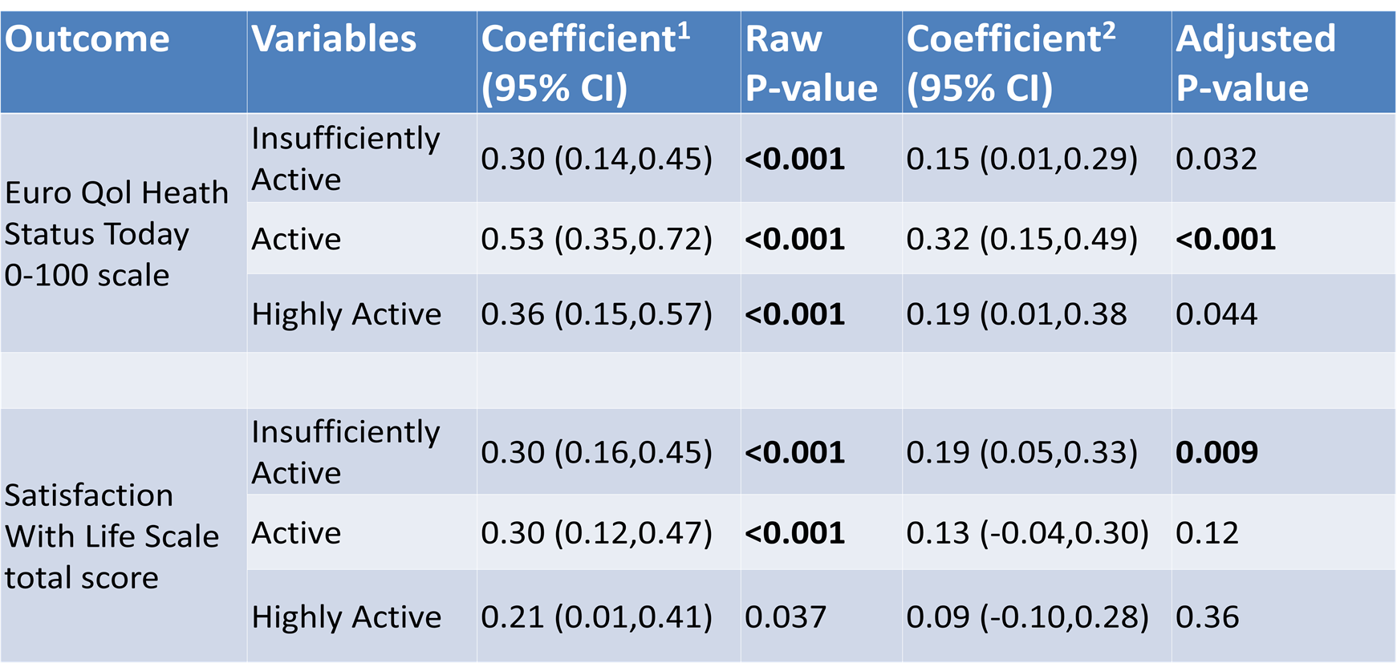
Abbreviated Regression Model Findings; Secondary Outcomes
Reference Group: Inactive
Multivariable Regression Models
¹First step regression ²Second step regression
Bolded p-values significant at Alpha = 0.05 with Bonferroni-Holmes correction factor (p<0.0125).

Slide 23
Take-home for Research & Clinical Care
Conclusion: Although cognitive performance on prespecified primary outcomes were similar, subjective well-being was better among SMs/Vs with remote mTBI who reported regular aerobic exercise.
Assimilation: Regular aerobic exercise has well demonstrated positive effects in the general population including an association with lower dementia risk.
Clinical Translation: Regular aerobic exercise is recommended for SMs and Veterans with chronic mild TBI.
Research Needed: Longitudinal analyses of the exercise-cognition relationship in chronic mTBI populations; objective measures of exercise dose would increase level of evidence.

Slide 24
Comorbidities and Lifestyle factors impacting key outcomes LIMBIC-CENC prospective study findings to date
Sleep apnea
Pain
PTSD
Depression
Aerobic physical activity & exercise
Alcohol misuse
Others under active investigation

Slide 25
Clinical care implications and recommendations For Treating Cognitive problems and Concerns in chronic Mild TBI
psycho-education
lifestyle factors including exercise
role of meds
cognitive compensatory strategies
cognitive rehabilitation

Slide 26
Maximize Cognition with Holistic Care
Provide Holistic Care via:
Empathy
Common goal setting
Education
Counseling on lifestyle factors
Progressive physical exercise
Symptom based approach
Address comorbidities (PTSD, chronic pain)
What to Avoid:
Prolonged passive therapies
Medications with cognitive or other significant side effects (e.g. benzodiazepines, gabapentin)
PolyPharmacy
Inferring patient’s condition is not ‘real’
Inferring you will ‘fix’ patient’s condition (instead, let them know that you will help them to better manage their lives)

Slide 27
Treatment of cognitive problems in chronic mTBI: Psycho-education
Goal: increase insight (consider neuropsych testing to guide*)
Favorable prognosis
Acceptance of possible over-attribution to mTBI history
Acceptance of role of comorbidities and other factors
Goal: Actuate self-management
Cognitive compensatory strategies
Lifestyle factors; actively changing
Engagement in treating non-TBI factors, especially stress reduction, sleep hygiene, SUD, and physical conditioning
*Objective findings often have little to no relation to either mTBI history or subjective cognitive functioning

Slide 28
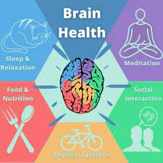
Education Touchstones
Movement throughout day (aim for 4,000+ steps/day)
Structured physical exercise
encourage aerobic component
consider formal physical therapy for focal difficulties
Sleep hygiene (aim for 7 hours/night of sleep)
Stress (mental/emotional) reduction
encourage use of relaxation training program
Nutrition (aim wt. control and healthy choices)
EtOH, tobacco and illicit substance use
Social interaction & cognitively active leisure pursuits
Role of Medications; discuss options and why you are advising for or against
When using: Counsel on goals, when to take, what good and bad may result; at f/u confirm usage
Cognitive & Communication compensatory strategies
Address misattribution to mTBI?
Notes:
Nutrition: plenty of vegetables, fiber and nuts. Consider dietary referral
Role of meds generally limited to comorbidities not responding well to non-pharmacologic treatments. If opting for medication treatment, determine target goals and consider exit strategy.

Slide 29
Physical Exercise with Emphasis on Aerobics and Daily Movement
Aerobic (‘cardio’) Exercise Dosing Recommendations
≥150 minutes low-moderate intensity aerobic activity per week
OR ≥ 75 minutes high-intensity activity per week
OR equivalent combination
Caveat: There is no magic threshold
Advise to promote more movement during daily life activities
Take stairs instead of elevators
Skip the moving walk-way in airport
Park further from destination
Do gardening or yard-work yourself
Some may benefit from step tracker to set goals
Notes:
Aerobic exercise notes:
Low-mod intensity example program to reach minimum: brisk walking x 45-60 min 3-4x/wk
High intensity example: running or swimming x 20-30 min 3-4x/wk
More than minimum is better for brain and overall health
Doing some, even if less than minimum, is still better than nothing

Slide 30
Addressing mTBI related Misattribution
Beliefs, attributions and expectations may adversely impact outcomes (Ozen & Fernandes, 2011).
Contributors of Misattribution include:
Proliferation of info in media on negative consequences of concussion(s)
Secondary gain (e.g. litigation, disability compensation)
Personality factors and ‘Good-Old Days’ syndrome
Attributional styles are mutable and can be successfully addressed (Peters et al., 2011)
Traditional model of assess and feedback is often ineffective in individuals with tightly held beliefs/attributions about concussion
Cross-disciplinary, behavioral approaches that draw upon elements of treatment for other chronic conditions might be needed (Belanger et al., 2020)
Notes:
From a clinical perspective, it is important to note that attributional styles are mutable and can be successfully addressed (Peters et al., 2011) . However, the traditional model of neuropsychological assessment and subsequent feedback, which may provide reassurance in other clinical populations, often is ineffective in individuals with tightly held beliefs/attributions about concussion. Cross-disciplinary, behavioral approaches that draw upon elements of treatment for other chronic conditions might best serve any patients who may have negative beliefs and sequalae from concussion(s). For example, Belanger et al. (Belanger et al., 2020) advocate for a three-phased approach including: assessment and education, targeted interventions directed at specific symptoms and comorbidities, and psychotherapy to address any mental health issues.
Ozen, L. J., & Fernandes, M. A. (2011). Effects of “diagnosis threat” on cognitive and affective functioning long after mild head injury. Journal of the International Neuropsychological Society: JINS, 17(2), 219–229. https://doi.org/10.1017/S135561771000144X
Peters, K. D., Constans, J. I., & Mathews, A. (2011). Experimental modification of attribution processes. Journal of Abnormal Psychology, 120(1), 168–173. https://doi.org/10.1037/a0021899
Belanger, H. G., Wortzel, H. S., Vanderploeg, R. D., & Cooper, D. B. (2020). A model for intervening with veterans and service members who are concerned about developing Chronic Traumatic Encephalopathy (CTE). The Clinical Neuropsychologist, 34(6), 1105–1123. https://doi.org/10.1080/13854046.2019.1699166

Slide 31
Cognitive Compensatory Strategies
Memory Problems
Maintain a schedule and routine
Unless PRN, take meds at same time(s) of day every day.
Make a ‘to do’ list every night and review every morning.
Keep commonly-used important items in consistent spot.
Place a large display where you often see it to keep important information such as appointments.
Use proven strategies to aid memory and avoid confusion or mistakes
Allow time for memory consolidation after learning new info
Keep info simple and repeat it to yourself frequently.
Use repeat back method for verifying verbal communication
Break activities in the simple steps
Always check written work in the same order such as left to right, up and down
Attention and Concentration Problems
Avoid multitasking
When pausing from task, write down what was done and what still remained
Use self-coaching techniques such as talking yourself through a task.
Consistently check over your work very carefully.
Schedule frequent breaks during the day.
Try to avoid interruptions.

Slide 32
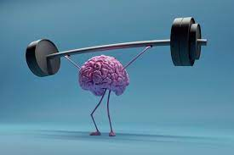
Cognitive Rehabilitation
Standard TBI cognitive rehab
Typically with SLP
Compensatory strategy training to integrate into daily life
Other individualized psychoeducation
Remediation training to improve executive function, memory, attention, and verbal fluency
Patients with comorbid PTSD
Also need Cognitive Behavioral therapy (CBT) and psychoeducation with psychotherapist
Could be integrated with TBI cognitive rehab

Slide 33
Poll Question #1 Which is required for eligibility into the LIMBIC-CENC Multicenter Prospective Longitudinal study (PLS) ? [choose the best answer]
Combat Exposure
Mild Traumatic Brain Injury
Cognitive impairment
Absence of PTSD

Slide 34
Poll Question #2 What group differences were found on cognitive performance? [choose the best answer]
History of any mild TBI(s) did poorer than controls
Repetitive mild TBI did poorer than controls
Blast-related mild TBI did poorer than controls
All mild TBI groups performed similarly

Slide 35
Poll Question #3 What differences were found between the groups endorsing aerobic exercise and the totally inactive group? [choose the best answer]
Better cognition for all levels (insufficient, active, highly active)
Better cognition only for the highly active group
Better perceived quality of life for most levels
Perceived quality of life was similar for all groups

Slide 36
Poll Question #4: What treatment is least helpful for patients with mTBI and persistent cognitive complaints or problems?
Cognitive compensatory strategies
Psychoeducation
Cognitive Rehabilitation
Memantine (Namenda™)

Slide 37
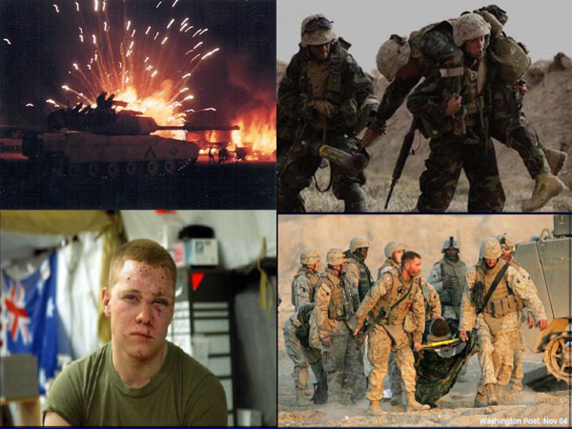
Questions?
The End
https://limbic-cenc.org
william.walker@vcuhealth.org

